Slide 1
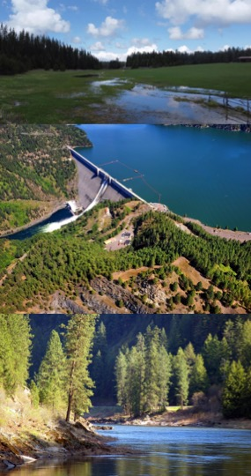






Integrated Models for Dynamic Water Quality Assessments
Todd E. Steissberg, PhD, PE
Environmental Laboratory
U.S. Army Engineer Research and Development Center (ERDC)
U.S. Army Corps of Engineers (USACE)
March 20, 2024

Slide 2



Integrated Environmental Modeling
Water Resources Models
Water Quality
Models
Ecological Models
Nutrients
Temperature
Dissolved Oxygen
Algae
Contaminants

Slide 3
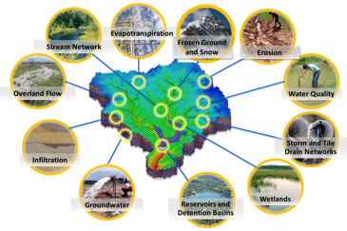
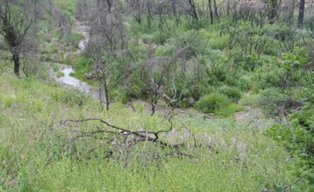
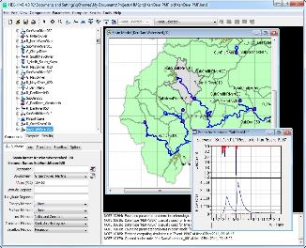
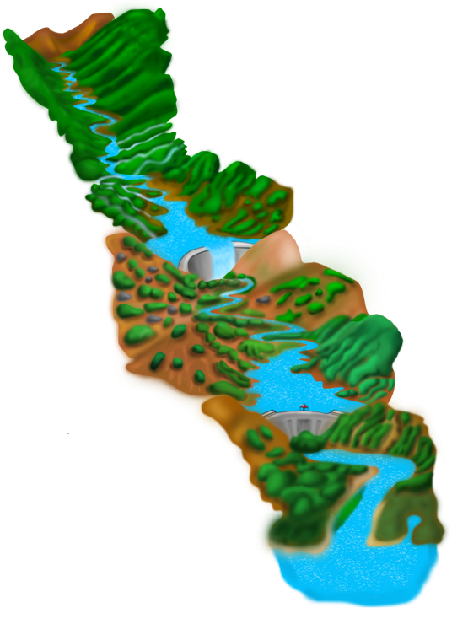
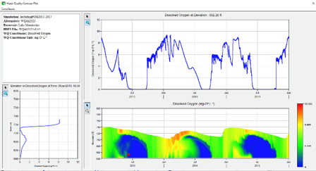
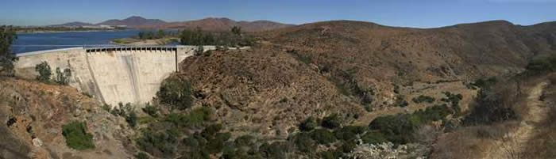
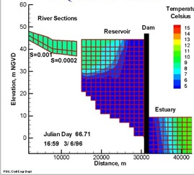
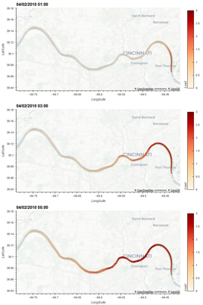
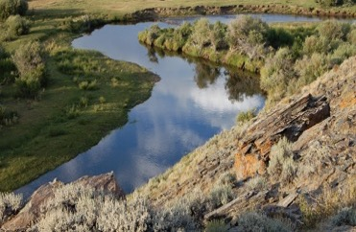
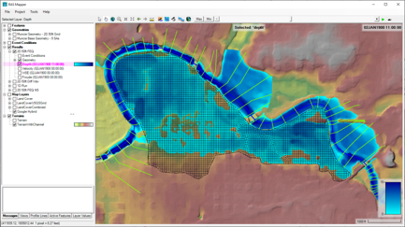
Water Quality and Environmental Systems Modeling
Temperature
Nutrients
Dissolved Oxygen
Algae
Metals
Contaminants
ERDC’s Corps Library for Environmental Analysis and Restoration of Watersheds (ClearWater) provides environmental simulation capabilities that leverage existing hydrologic and hydraulic (H&H) models.
Water quality modeling tools:
Watershed Runoff:
GSSHA: Surface and sub-surface water quality modeling
HEC-HMS: Surface runoff temperature modeling
Reservoirs:
CE-QUAL-W2: 2D reservoir-river hydrodynamics and water quality modeling
HEC-ResSim: Reservoir operations and water quality modeling
Rivers and Floodplains:
HEC-RAS: 1D River hydraulics and water quality & vegetation modeling
ClearWater-Riverine: 2D River-floodplain hydraulics and water quality modeling with HEC-RAS-2D
Estuary
Key: ERDC-EL – ERDC-CHL – HEC

Slide 4
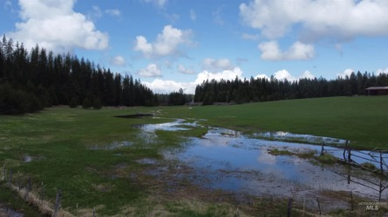
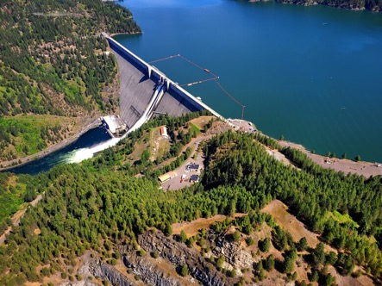
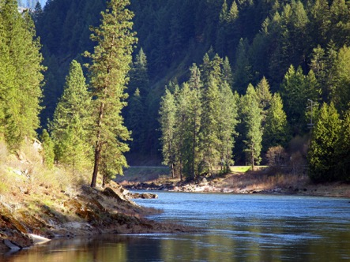
ClearWater: Next Generation Integrated Water Quality Modeling
ClearWater: Corps Library for Environmental Analysis and Restoration of Watersheds
Purpose: Link environmental models with existing water resources models that simulate runoff, rivers, and reservoir hydraulics and hydrology
ClearWater provides environmental simulation capabilities that are designed to leverage existing water resources models.
The ClearWater water quality modules simulate constituent kinetics, heat budget processes, and vegetation growth cycles. Capabilities include:
NSM: Nitrogen, phosphorus, and carbon cycling; dissolved oxygen, algae, etc.
TSM: Temperature (heat budget)
GSM: General Constituents
CSM: Organic and inorganic contaminants
MSM: Mercury
ClearWater contains legacy modules written in Fortran and C++ and next-generation modules written in Python (NSM and TSM)
Engine computes the transport (advection and diffusion) of heat and constituent mass across the watershed
Data visualization capabilities
Framework to integrate multiple models.
Runoff
Reservoirs
Rivers

Slide 5
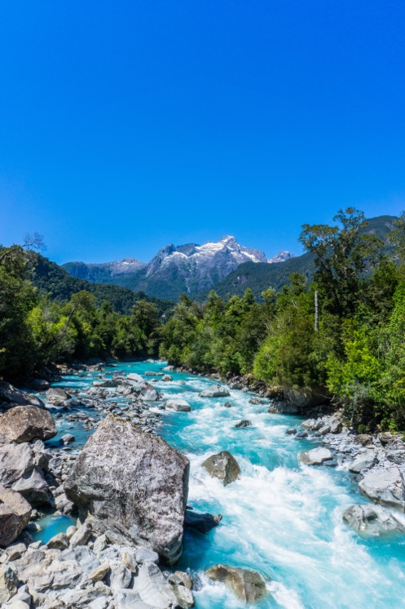
ClearWater-Riverine
Clearwater-Riverine simulates temperature and advanced nutrient cycling in branching river systems and floodplains, incorporating hydrodynamic, water quality, and meteorologic inputs from multiple data sources and models.
Flows: The model grid, volumetric flow, velocities, depths, diffusivity, etc. are provided by existing 2D water resources models.
HEC-RAS (2D)
GSSHA (in progress)
Modules: Water quality kinetics and heat budget simulation capabilities in ClearWater-Riverine are furnished by ERDC's ClearWater modules (e.g., NSM).
Transport: The ClearWater transport engine computes advection-diffusion of heat and mass through the model network.
Framework: The ClearWater framework links all the components together and performs the water quality compute sequence.
Currently design is based on decoupled modeling, i.e., the flows are pre-computed by the hydro models.

Slide 6
ClearWater-Riverine Example: E. Coli Transport in the Ohio River

Slide 7
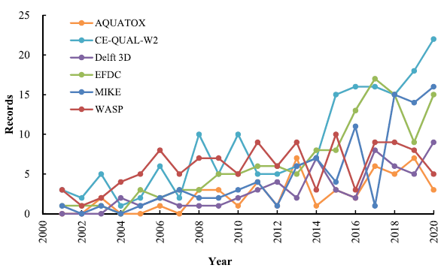
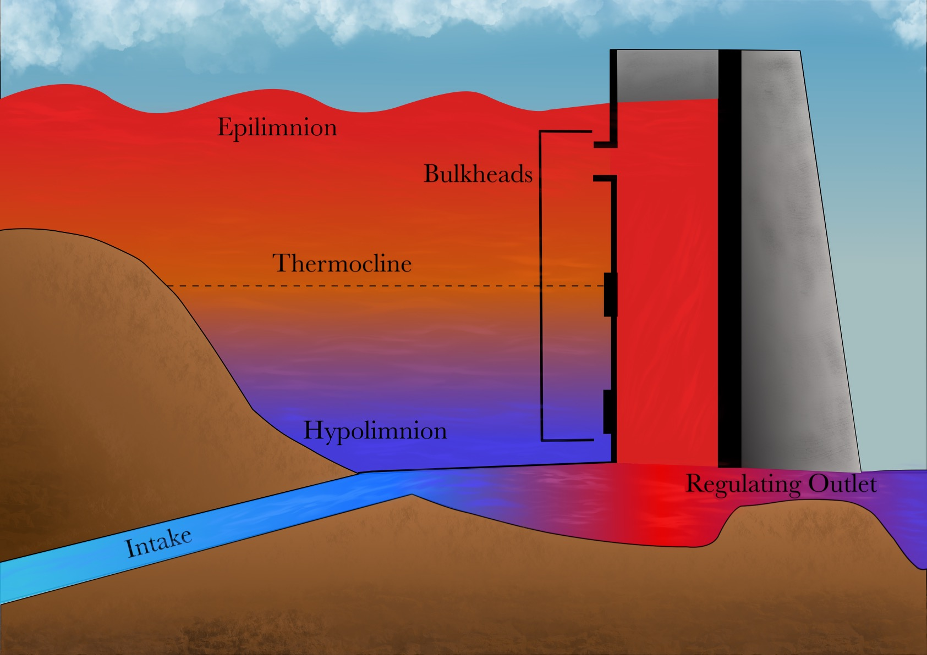
CE-QUAL-W2
CE‐QUAL‐W2 is a two‐dimensional (2D), longitudinal/vertical, hydrodynamics and water quality model that enables characterization of vertical and longitudinal changes in reservoirs.
The model assumes reservoirs are well mixed laterally, with no variation from one channel side to the other in a layer (vertical) and segment (longitudinal).
CE-QUAL-W2 has been applied to rivers, lakes, reservoirs, and estuaries.
Ecological Modelling 466 (2022) 109888

Slide 8

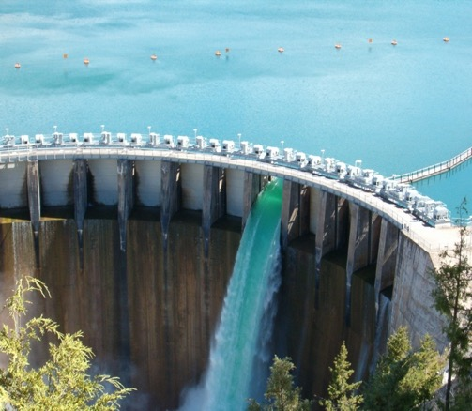
CE-QUAL-W2 Capabilities
Longitudinal-vertical hydrodynamics and water quality in stratified and non-stratified systems
Nutrients-dissolved oxygen-organic matter interactions
Fish habitat
Selective withdrawal from stratified reservoir outlets
Hypolimnetic aeration
Multiple algae, epiphyton/periphyton, zooplankton, and macrophytes
CBOD
Sediment diagenesis model
Generic water quality groups
Internal dynamic pipe/culvert model
Hydraulic structures (weirs, spillways) algorithms, including a dynamic shading algorithm based on topographic and vegetative cover.
Water age – Useful for forensic analyses

Slide 9
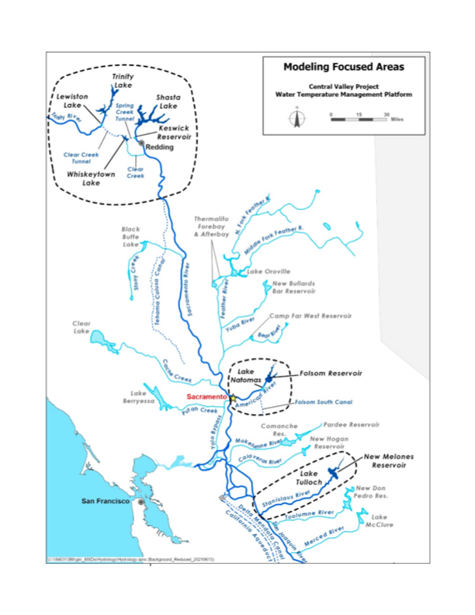
Past and Current Applications of CE-QUAL-W2
CE-QUAL-W2 is widely used by USACE and other federal, state, and local agencies for environmental impact assessments, planning studies, etc. Agencies that use CE-QUAL-W2 as their standard reservoir water quality model include:
U.S. Geological Survey (USGS)
U.S. Bureau of Reclamation
U.S. Environmental Protection Agency (EPA)
State of California
More than 1,100 model applications have been developed worldwide for reservoirs, rivers, estuaries, and other water bodies since CE-QUAL-W2 was released in 1986.
CE-QUAL-W2 is also used as a research tool by researchers at universities and other organizations.
At least 1,500 publications utilized or cited CE-QUAL-W2 in the year 2022 alone.
Recent Studies:
Water Temperature Modeling Platform, California Central Valley Project (USBR and State of California): This platform applies CE-QUAL-W2 for ongoing and future operations decision-making
USACE Northwest Division, Columbia and Snake River Watershed
Columbia System Reservoir Operation (CRSO) Project
Columbia River Treaty (CRT) Project
Philadelphia District, Lehigh River Water Quality Modeling
Region of Application:
Water Temperature Modeling Platform
California Central Valley Project

Slide 10
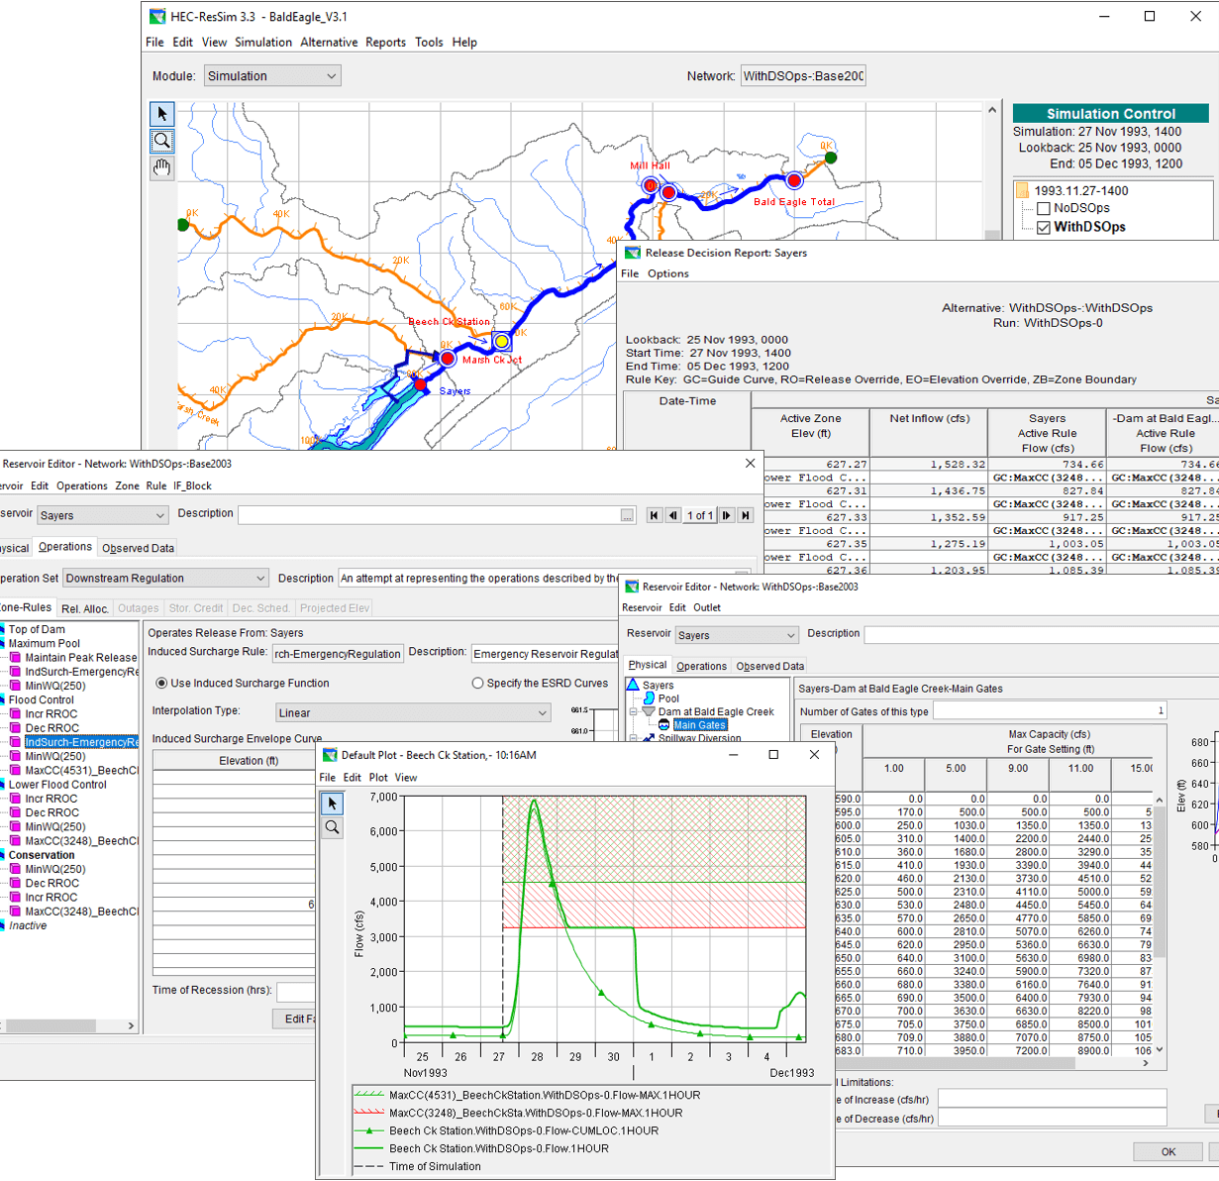
HEC-ResSim Water Quality Model: Reservoir Operations
Develop fully integrated water quality capabilities into HEC-ResSim (Reservoir System Simulation)
HEC-ResSim simulates reservoir operations at one or more reservoirs for:
Flood management
Low flow augmentation
Water supply
Applications:
Planning studies
Detailed reservoir regulation plan investigations
Real-time decision support

Slide 11
Integrating Water Quality in Reservoir Release Decision-Making
Old Approach:
WQ was simulated after computing the hydrology and release decisions.
WQ operation rules were specified indirectly (using stage and flow) to meet environmental objectives.
Environmental objectives were often combined with other objectives, like navigation, flood control, or hydropower.
If the desired environmental benefits of an alternative are not achieved, new guesses need to be made, and the simulation recomputed. This stage has often been neglected.
Old Approach
New Approach
New Approach:
WQ is simulated in parallel with the hydrology and release decisions.
WQ operation rules can be specified directly (temperature, concentration, or load) to meet environmental objectives.
Environmental objectives can be specified and managed independently of other objectives, clarifying the environmental impacts of operation decisions.

Slide 12
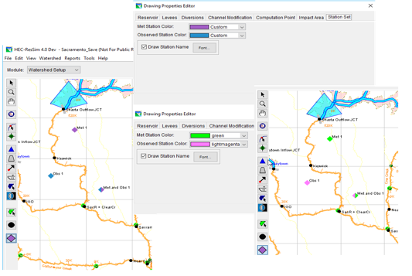
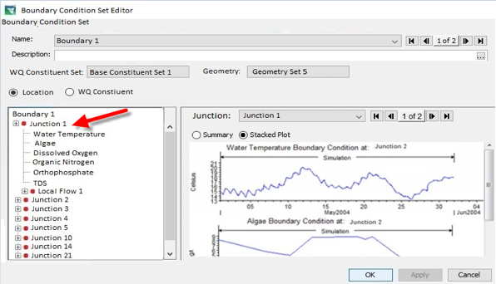
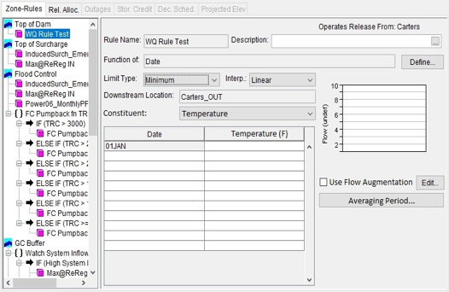
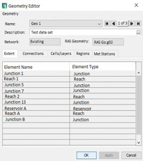
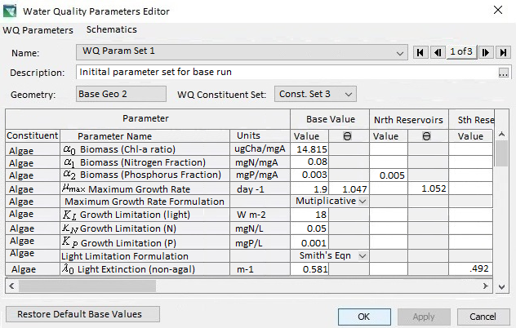
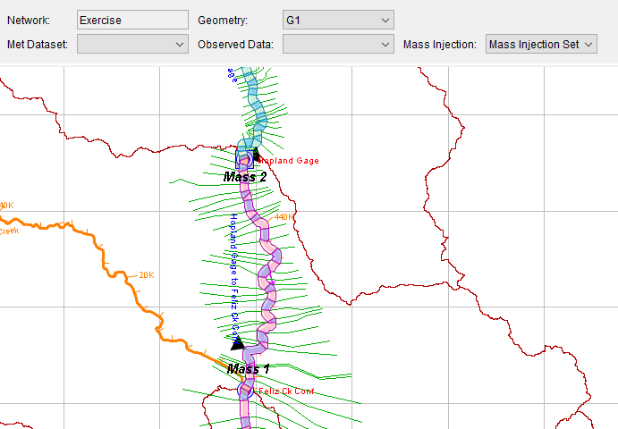
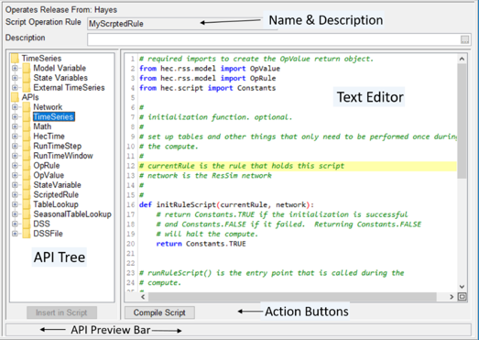
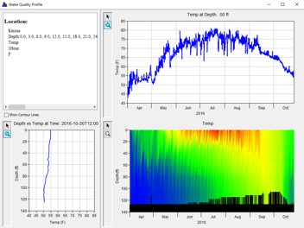
HEC-ResSim Water Quality Modeling User Interface
Model Geometry
Specifying Boundary Conditions
Operating Rule Priorities
Constituent Relation Parameters
Visualization
Scripted Rules and State Variables

Slide 13
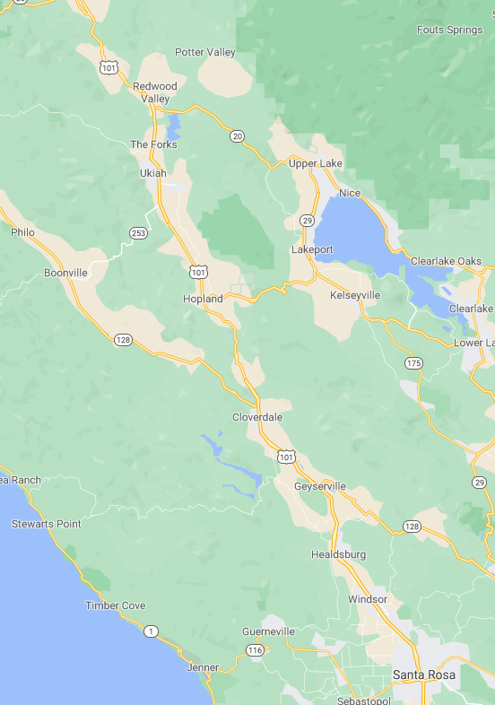
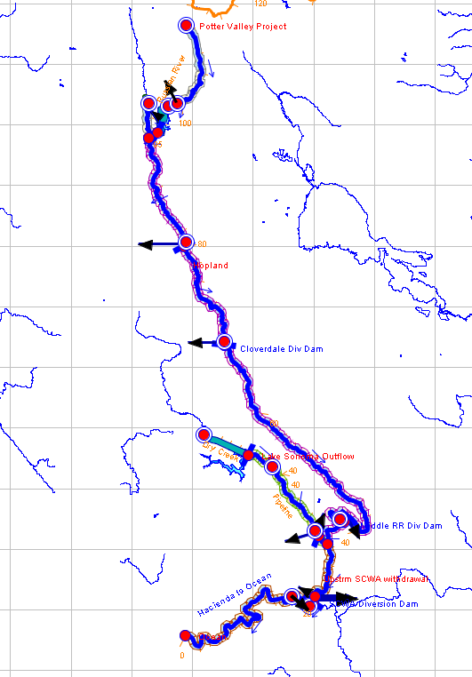
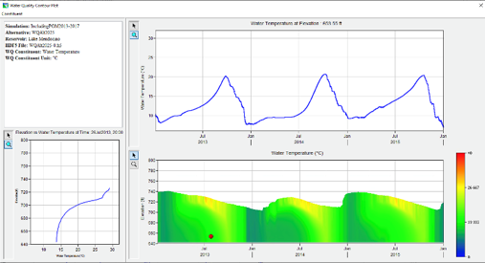

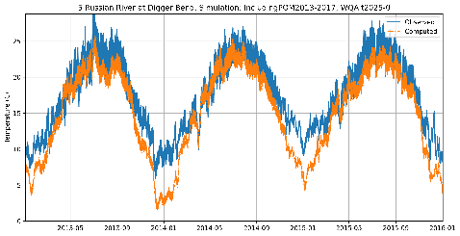
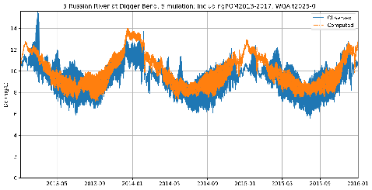
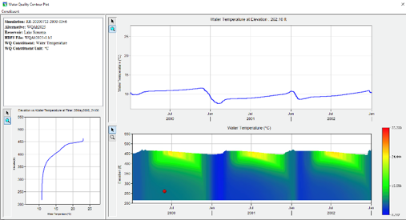
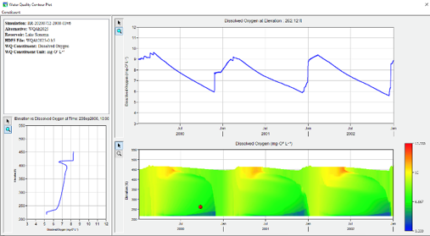
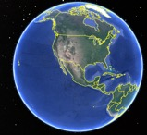
Temperature and Dissolved Oxygen Simulation with HEC-ResSim Russian River, California Prepared by RMA for the Sonoma County Water Agency
Temperature
Dissolved Oxygen
Lake Mendocino
Temperature
Dissolved Oxygen
Lake Sonoma

Slide 14
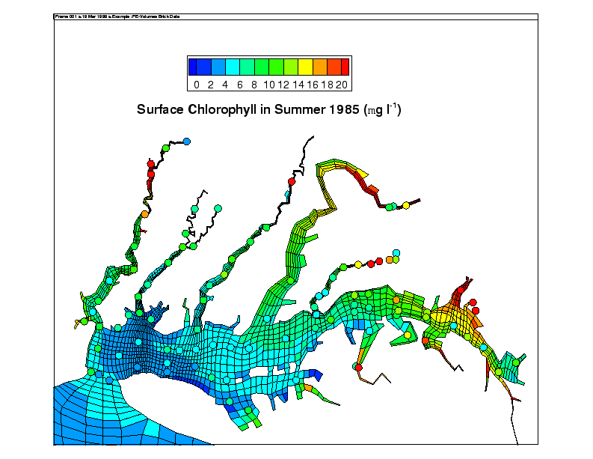
CE-QUAL-ICM
POC: Dr. Barry Bunch, ERDC-EL
Three-dimensional (3D) simulations of water quality in estuaries and complex environments
Full suite of nutrients and trophic interactions
Includes SAV, benthos, zooplankton, sediment diagenesis
Conventional pollutants and contaminants (ICM/TOXI)
Water quality linked with hydrodynamics
Developed through Chesapeake Bay study
Generalized, public domain, and applied to many other sites

Slide 15
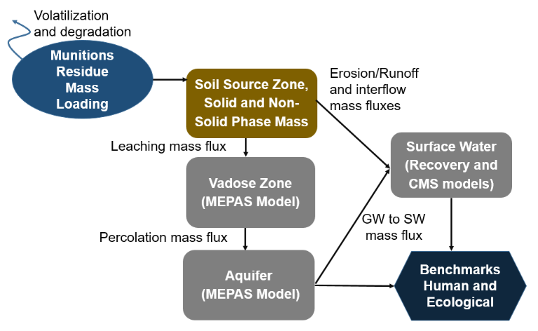
Groundwater Quality
POC: Dr. Jodi Ryder, ERDC-EL
Off-the-shelf hydro and BioGeoChem models used for applications
MODFLOW
FemWater
HydroGeoSphere
PHREEQC+
MINEQL+
Model choice largely driven by customer history and the BioGeoChem processes needed for the case
Interest in improved Groundwater-Surface Water BioGeoChem processes
Interest in developing PFAS workflow, MEPAS replacement
FRESCO
System of 1D, lumped parameter models
Applied for screening worst case scenarios aligned to ORAP
Current continued development of constituent databases and exploration of application for PFAS
Notes:
MEPAS: Multimedia Environmental Pollutant Assessment System (https://www.osti.gov/biblio/7012993)
PFAS: Per- and Polyflouroalkyl Substances
PFOS: Perfluorooctane Sulfonic Acid

Slide 16

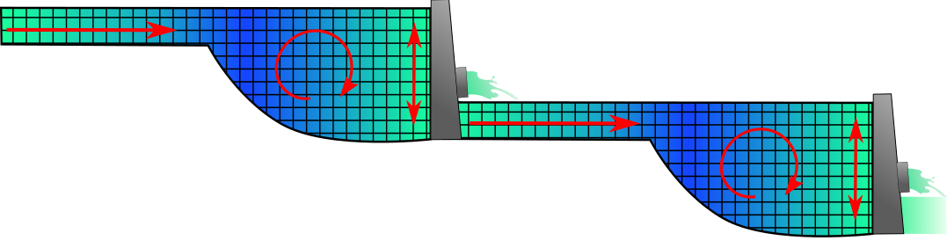
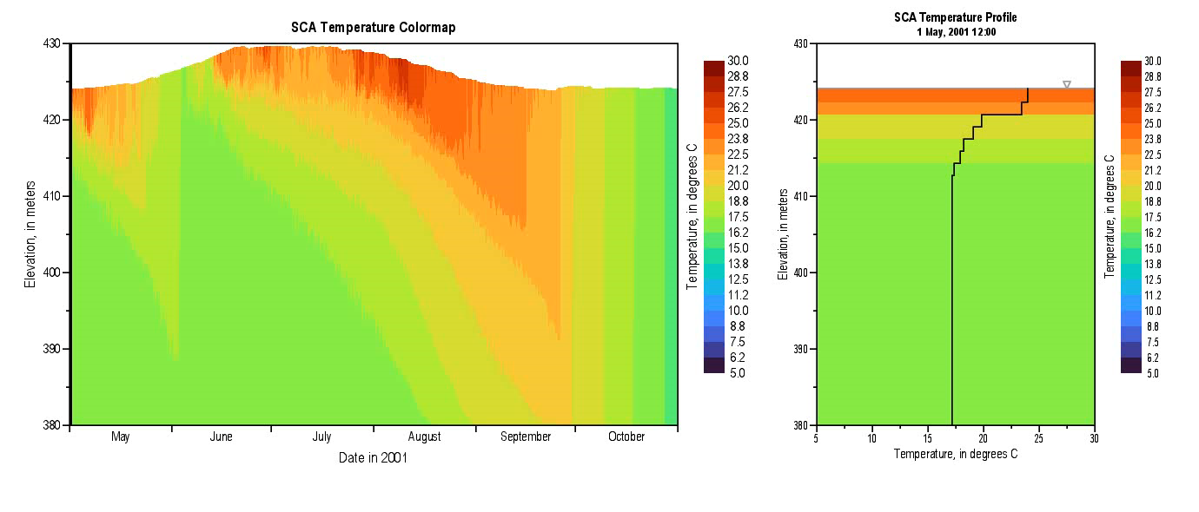
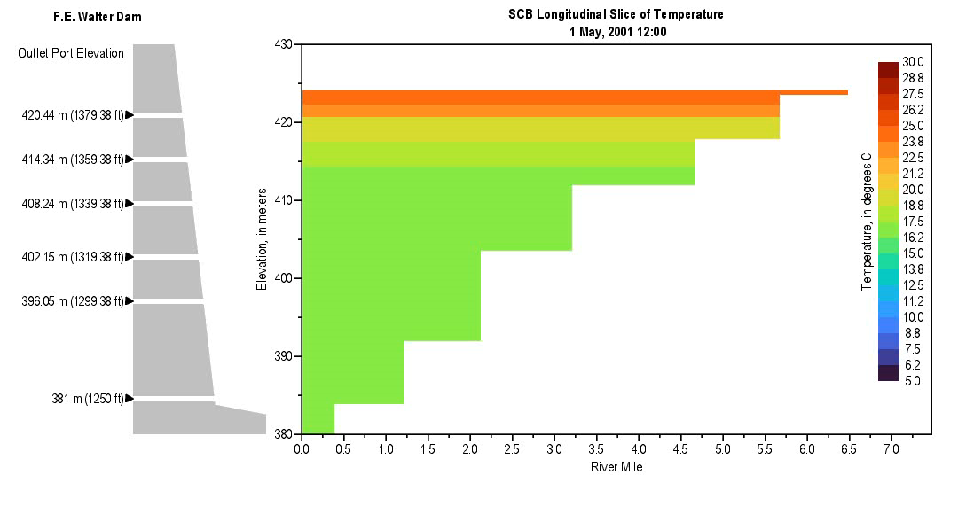
Using Water Quality Models for Forensic and Impact Analysis
Source Identification: Trace the origin of pollution incidents through scenario analyses.
Spatial-temporal analysis:
Determine the spread and transformation of contaminants in the water system.
Contaminants may spread through river, floodplain, and stormwater environments.
In reservoirs, the vertical location of contaminants controls chemical reactions related to oxygen and temperature levels.
Understand the timeline of pollution events through animations of water quality simulations.
Impact Evaluation: Assess environmental and public health consequences.
Example: Evaluate contaminant concentrations near drinking water plan intakes.
Rivers, floodplains, stormwater systems:
Reservoirs:

Slide 17

Questions?

